Slide 1

CHURN PREDICTION
STEVANO SATRIA NATHANAEL
Notes:
Purwadhika Digital Technology School is inviting you to a scheduled Zoom meeting.Topic: Project Presentation JC DS
Time: This is a recurring meeting
https://zoom.us/j/861396530?pwd=MnRaQ3FJN2RSa1dFRDZ3TjR5OUM4Zz09
Meeting ID: 861 396 530
Password: purwadhika
Find your local number: https://zoom.us/u/adfdopI3Wn

Slide 2
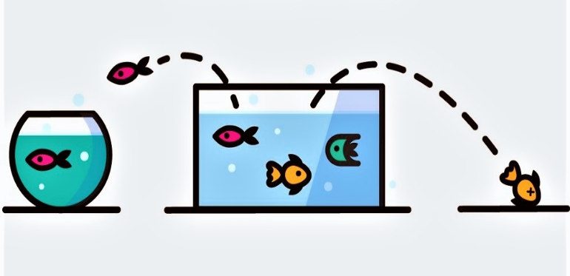
What is Churn?
“Customer churn, also known as customer attrition, occurs when customers stop doing business with a company. The companies are interested in identifying segments of these customers because the price for acquiring a new customer is usually higher than retaining the old one.”
https://towardsdatascience.com/churn-prediction-770d6cb582a5

Slide 3
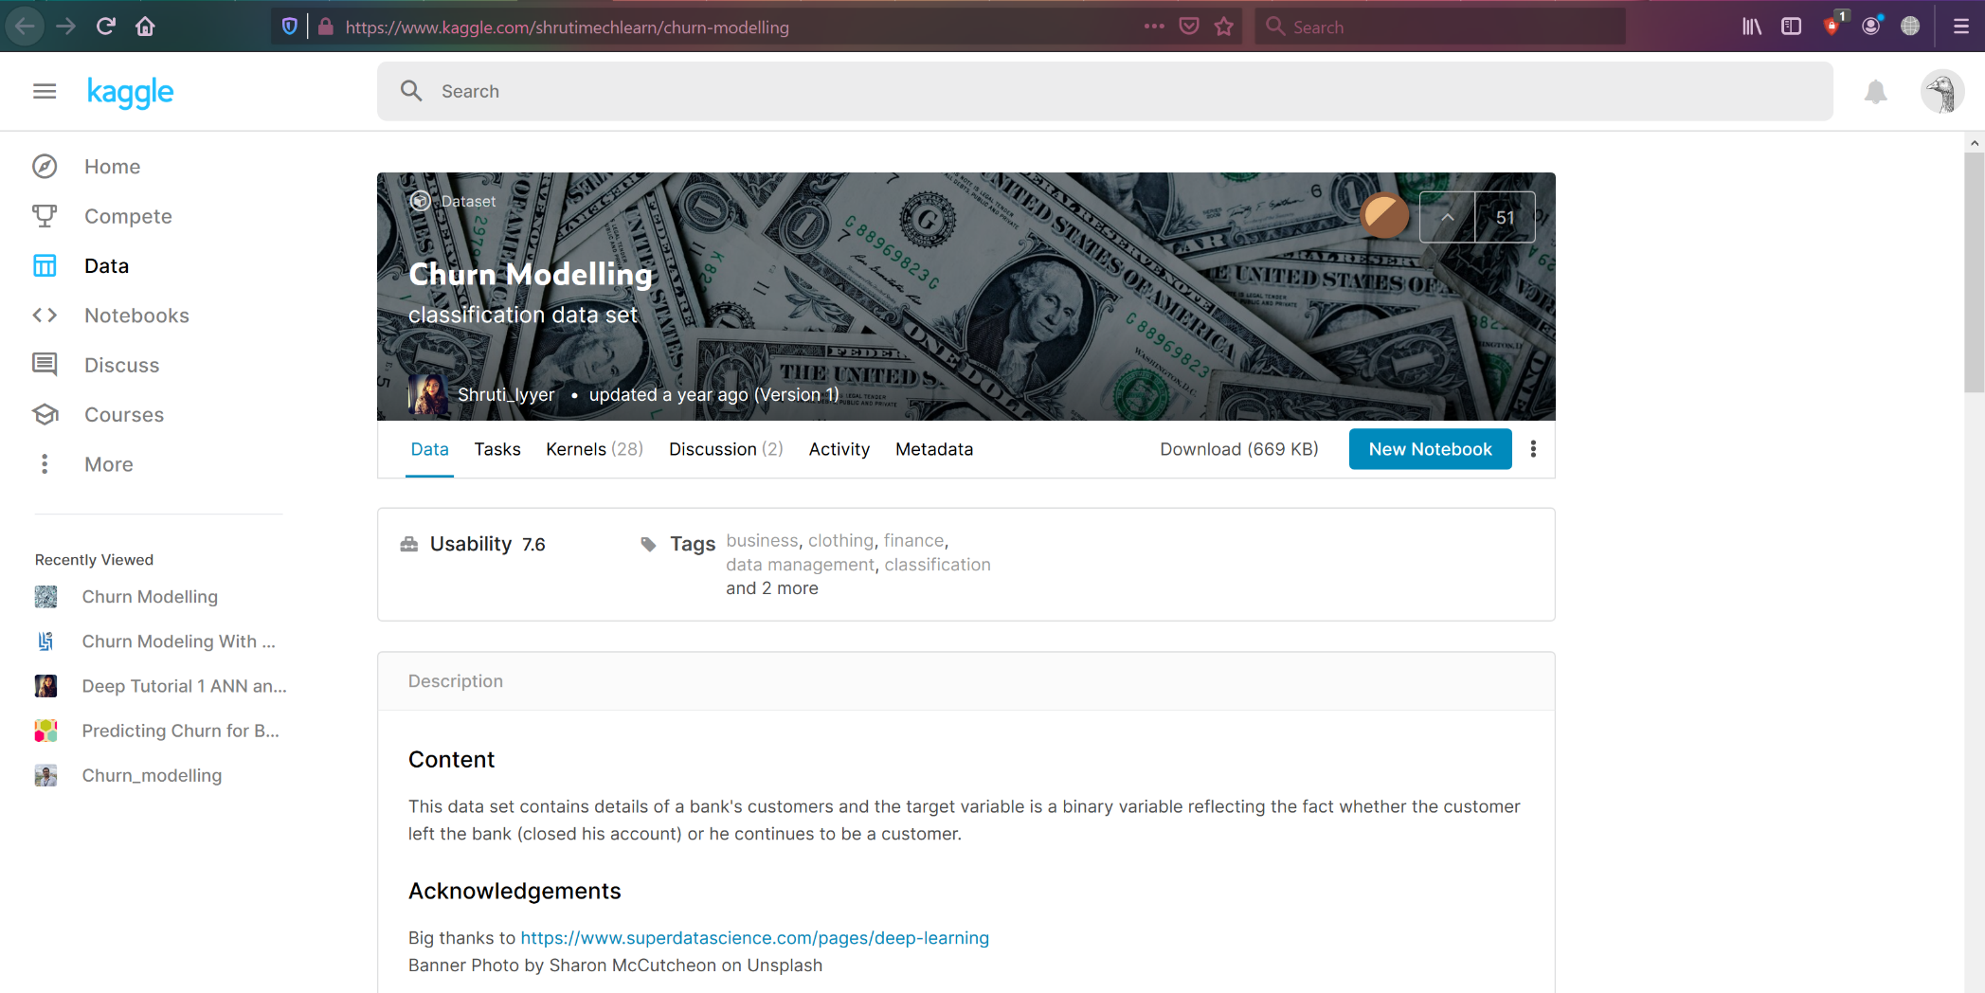
The Data

Slide 4
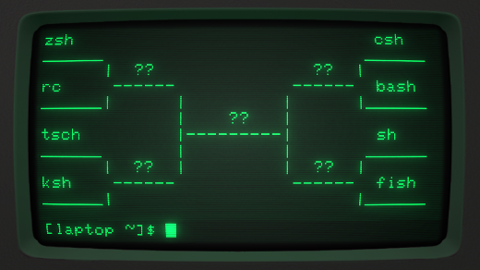
Columns Description
Customer ID: This attribute is unique and assume that primary key
Surname: it belongs to surname of customer and string values
Geography: it shows country of customer
Gender: male/female
Credit Score: it gives credit score of customers. That score calculates interbank system. High score shows that the customer debt high repayment capacity.
Age: age of customers
Tenure: The number of ages the customer is in the bank.
Balance: Customer's money in the bank.
Number of Products: Number of products owned by the customer.
Credit Card: Whether the customer has a credit card
Active Status: Customer's presence in the bank
Estimated Salary: Customer's estimated salary
Exited: Churn or not

Slide 5


Preprocessing And EDA
Remove un-needed columns
Check missing values
Check feature types
EDA Plots
Normality and Correlation Check (Spearman-Pearson and CramersV)

Slide 6

Model Training
1. Dummies for categorical values
2. Standard Scaling
3. SMOTE
4. Machine learning Algorithm:
Logistic Regression
Decision Tree Classifier
Random Forest Classifier
XGBoost Classifier
5. Split into 4 runs:
Normal
Scaled
Scaled with Tenure as category(dummied)
Scaled with Tenure and HasCrCard removed(based on cramersV results)

Slide 7
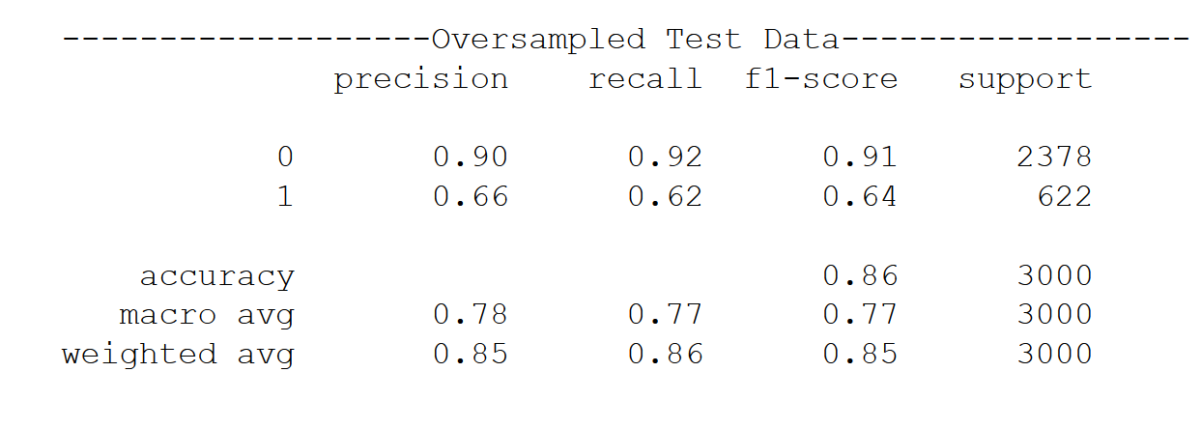
Best Result
Best Result
Scaled data with XGBoost Classifier

Slide 8
Decision Tree and Random Forest models may be overfit, given the classification reports scores on train data are all 1.00 while the scores on test data were decreased more compared to XGBoost model.
XGBoost scores (recall and accuracy) were higher than Logistic Regression

Slide 9

Model Evaluation and Tuning
AUC-ROC
Cross Validation
Learning Curve
GridSearchCV
Notes:
Scoring and tuning were focused on maintaining good score on accuracy and ‘not churn’ class(churn[‘Exited’]==0) recall while trying to increase the recall on ‘churn’ class.

Slide 10

Results
4 key Features:
Age – making promos based on age
Tenure – create contract or promos based on how long the customer had stayed in the bank
Num of Products – reevaluate each product program
Customer’s Activity – increase engagements throughout the product services

Slide 11
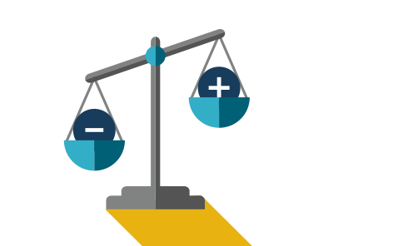
Recall on churned customer could be increased by setting the threshold on the hyperparameters using the auc-roc measurement. But then again, it depends on how the company wanted to operate their sales strategy. Better recall score leads to more potential churned customer predicted, resulting in more cost by company to spend on customer retention plan.

Slide 12


